Slide 1


Slide 2

PRESENTATION SKILLS -2

Slide 3

From Blank Slate to Brilliant Presentation: Your Guide

Slide 4
Preface
In today's fast-paced world, the ability to communicate ideas clearly and visually is more important than ever.
PowerPoint has become a ubiquitous tool for presentations, allowing us to share information, persuade audiences, and inspire action. Throughout this presentation, we will explore the following key areas:
Introduction
Body
Conclusion
Font and Color Usage
.Rules and Guidelines:.

Slide 5

Introduction
Definition: The opening section that sets the
stage for your presentation.
Purpose: To grab attention, introduce the topic, and provide a roadmap of what to expect.
Key Elements:
Attention-grabbing opening (e.g., a quote, question, or surprising fact)
Brief background information
Clear thesis statement or presentation objective

Slide 6

Crafting an Effective Introduction
Start with a hook to engage your audience.
Provide context and background information relevant to your topic.
Clearly state the purpose or thesis of your presentation.
Outline the main points you will cover.

Slide 7
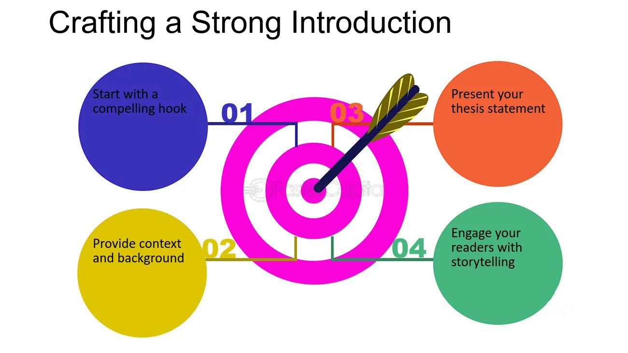

Slide 8

Key Elements of a well structured Introduction
Attention-Grabbing Opening: Start with a hook to capture the audience's interest. This could be a compelling question, a surprising fact, a relevant quote, or a brief anecdote.
Background Information: Provide some context or background information that is relevant to your topic. This helps the audience understand the significance of the subject matter.

Slide 9

Key Elements of a well structured Introduction
Clear Thesis Statement or Objective: Clearly state the purpose of your presentation. This is your main argument or the central message you want to convey.
Preview of Main Points: Outline the main points you will cover in your presentation. This gives the audience a roadmap of what to expect and helps them follow along more easily.

Slide 10

Key Elements of a well structured Introduction
Relevance and Connection to the Audience: Explain why the topic is important and how it relates to the audience. This helps to engage them and maintain their interest throughout the presentation.
Transition to the Body: Conclude your introduction with a smooth transition to the body of the presentation. This could be a statement that leads directly into the main point.

Slide 11
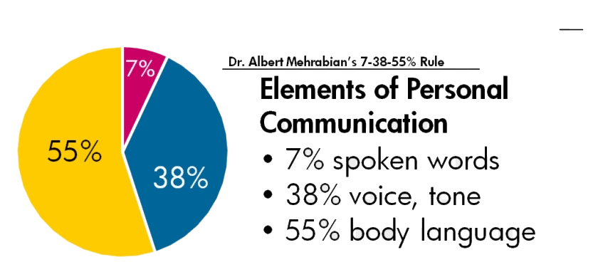

Slide 12

Common Mistakes to avoid when writing an Introduction
Starting with a Weak Opening
Providing Too Much Background Information
Lack of Clarity in the Thesis Statement
Failing to Connect with the Audience

Slide 13

Common Mistakes to avoid when writing an Introduction
Poor Transition to the Body
Using Jargon or Technical Terms Without Explanation
Reading Directly from the Slides
Overwhelming with Too Many Main Points
Neglecting Visual Aids

Slide 14
The Body
Definition: The main content of your presentation where you present your arguments, evidence, and key points.
Purpose: To develop your topic, provide evidence, and support your thesis.
Key Elements:
Clear organization (e.g., chronological, spatial, problem-solution)
Use of headings and subheadings to guide the audience
Supporting details, examples, and data
Transitions between points to maintain a logical flow

Slide 15
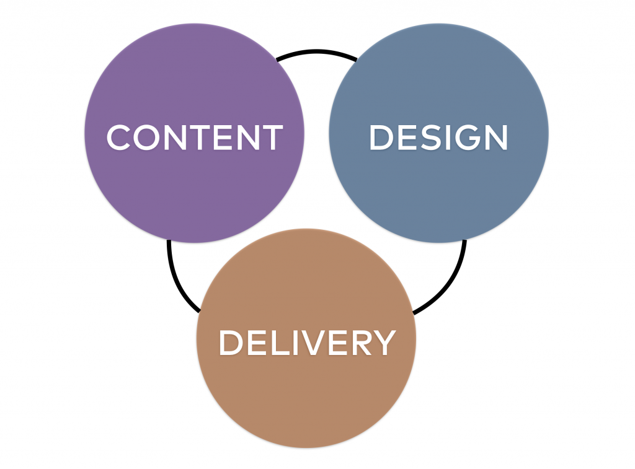
Design Principles for Effective Presentations
Choosing the Right Fonts for Clarity
Font Legibility
Font Size and Hierarchy
Consistency in Font Usage
The Role of Color in Enhancing Readability
Color Contrast
Color Psychology
Consistent Color Scheme
Notes:
Font Legibility: Selecting fonts that are easy to read is crucial for ensuring that your audience can quickly grasp the information presented. Sans-serif fonts like Arial or Helvetica are often recommended for digital presentations due to their clean lines and simplicity, which enhance readability on screens.
Font Size and Hierarchy: Utilizing a clear hierarchy in font sizes helps guide the audience's attention to key points. Titles should be larger and bolder, while body text should be smaller but still legible, typically ranging from 24 to 32 points for headings and 18 to 24 points for body text, depending on the presentation format.
Consistency in Font Usage: Maintaining consistency in font choice throughout the presentation fosters a professional appearance and aids in audience comprehension. Limit the use of different fonts to two or three styles—one for headings, one for body text, and possibly a third for emphasis—to avoid visual clutter and confusion.
Page 2.2: The Role of Color in Enhancing Readability
Color Contrast: Utilizing high contrast between text and background colors is essential for readability. For instance, dark text on a light background or vice versa can significantly improve legibility, allowing the audience to easily read and comprehend the information presented without straining their eyes.
Color Psychology: Different colors evoke various emotional responses and can influence audience perception. Understanding color psychology can help presenters choose colors that not only enhance readability but also align with the message's tone, thereby reinforcing the overall impact of the presentation.
Consistent Color Scheme: Implementing a consistent color scheme throughout the presentation aids in creating a cohesive visual experience. This consistency helps guide the audience's focus and makes it easier for them to follow along, as well as reinforcing brand identity or thematic elements associated with the content being presented.

Slide 16

Design Principles for Effective Presentations
Layout and Organization of Slides
Logical Flow of Information
Use of White Space
Consistent Slide Design
Utilizing Visuals to Support Your Message
Enhancing Comprehension
Creating Emotional Connections
Supporting Key Points

Slide 17

Rules related to Presentation
5/5/5 Rule
Remember the 10/20/30 Rule
Seven by Seven Rule
The One-minute test
The one Principle
Image Rule
Rule of Thirds

Slide 18

Rule of thirds
The design rule of thirds is where you break up an image or design into different sections using columns and rows to form a grid.
The grid is placed over the image and has nine equal boxes with three evenly spaced rows and columns.
The goal of the rule of thirds is that you don’t place the main elements in the center of images. You place the main elements on either the left or right.

Slide 19

5/5/5 rule
You shouldn’t have more than five words per text in a line.
Each slide should have no more than five lines.
You shouldn’t have more than five text-heavy slides in a row

Slide 20

7/7 rule
The seven-by-seven rule is where you use no more than seven words per line and no more than seven lines per visual.
If you need more words, make bullet points as sub-points below the main point.
The maximum is one key point with six subpoints on a single slide.

Slide 21

One minute test
The one-minute test is where you put yourself in the audience's shoes.
If your audience needs more than one minute to figure out what your slide says, then it’s too complex.
If your slide is too complex, it can cause your audience to lose focus on what you’re saying.

Slide 22
Image Rule
The image rule is that you should use an image that is relevant to your presentation.
The One Principle
The one principle is similar to the image rule. It states that you should limit each visual to one idea, concept, or main point.
10/20/30 Rule
The 10/20/30 rule says a presentation should be no more than ten slides longer than twenty minutes and use fonts no smaller than thirty.

Slide 23
The Conclusion
Definition: The final section that wraps up your presentation and leaves a lasting impression.
Purpose: To summarize key points, reinforce the thesis, and provide a sense of closure.
Key Elements:
Restate the thesis or main points in a new way.
Summarize the key evidence or arguments.
Offer a final thought, call to action, or future implications.

Slide 24

Crafting a strong Conclusion
Recap the main points.
Emphasize the significance of your topic.
End with a memorable statement or call to action.
Avoid introducing new information.

Slide 25

Tips for all sections
Use concise and clear language.
Maintain a logical flow throughout the presentation.
Tailor your content to your audience.
Practice your delivery to ensure timing and engagement.

Slide 26
THANK YOU

